Slide 1
B09S0061 Software Engineering
Lecture 11
Instructor: Liu, Guangchi Ph.D.
2025/05/17
Notes:
本模板基于“中国科学院大学-路人丁-PPT模板”魔改而成，著作权归该作者所有。
本模板中使用的东南大学校徽、校标文字组合、校训文字等素材来自于微信公众号“金木屋”。
本模板的视觉设计参考了“东南大学视觉识别系统”。
人物介绍页头像素材来自 小肥柴。
本模板力求简洁，布局合理，主次分明。以学术风为设计理念，适用于学术报告与论文答辩等相关应用场景。模板未使用任何动画效果。
您仅可以以个人非商业用途使用本PPT模板，不可将信息内容的全部或部分用以出售，或以出租、出借、转让、分销、发布等其他任何方式供其他人使用。
欢迎 持续关注东南大学止于至善学术风 PPT 模板 （https://zhuanlan.zhihu.com/p/335298500）后续的功能优化及多语言更新版本。
最后，祝汇报顺利，马到成功！
Version: (2021) v1.5-en.

Slide 2
Heads Up
3rd Lab: May 17th (Saturday), 14:00 – 17:25, J6-102

Slide 3
Heads Up
Final Exam Date: TBD
Coverage: Lecture 1-11
Will have a course review in Lecture 12

Slide 4
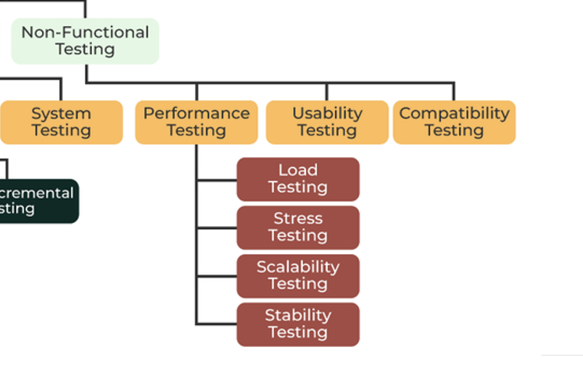
Non-Functional Test
Performance Test
Ensures software applications perform properly under their expected workload
Usability Test
To understand whether the machine is ready to come on the market
Compatibility
To check its compatibility (running capability) on different platforms/environments.

Slide 5
Performance Bug
Does not meet deadlines / satisfy SLA
Responsiveness, smoothness do not meet requirements
100 ms: GUI
15-30 ms: Animation (30-60 fps)
10 ms: MIDI, VR
Unexpected slowdown for certain inputs / DoS vulnerability
Performance regression (gradual and acute degradation)
Performance variability across platforms
Sub-optimal throughput for HPC

Slide 6
Performance Test
Load Test
Response of the system measured under varying load conditions
For normal and extreme load conditions.
Simulates a real-world load on a system to see how it performs under stress.
Identify bottlenecks and determine the limits the system can handle.
Ensure that the system can handle the expected usage levels

Slide 7
Performance Test
Stress Test
Given unfavorable conditions to the system and check how it perform in those conditions.
designed to test the run-time performance of software within the context of an integrated system
It is used to test the speed and effectiveness of the program

Slide 8
Performance Test
Scalability Test
Test the capability to scale up or scale down the number of user request load or other such performance attributes.
It can be carried out at a hardware, software or database level.
Ensures that a software product can manage the scheduled increase in user traffic, data volume, transaction counts frequency, and many other things
Stability Test
Checks the quality and behavior of the software under different environmental parameters and over time without failure.

Slide 9
Performance Test Challenges
How much room for improvement is there?
Amdahl's law: Limits to speedup from parallelization, local optimization
Roofline analysis: Do you expect to be limited by bandwidth or compute?
Is slowdown localized, dispersed, or emergent?
Getting reliable measurements is difficult
Inconsistency, load dependency, JIT compilation, non-representative datasets
Average case vs. worst case
Tension between latency and bandwidth

Slide 10
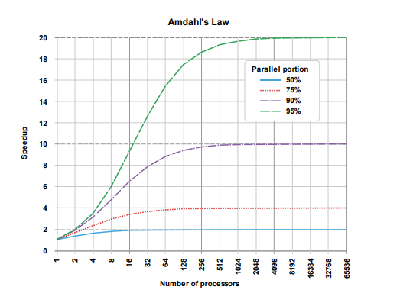
Amdahl's Law
Speedup: S = T_before / T_after
Identify portion p of runtime cost amenable to optimization
T_before = p*T + (1 - p)*T
Let s be speedup of optimization on this portion
Example: s = 10 for parallelizing on a 10-core machine
Often interested in limit as s → ∞
T_after = p*T/s + (1 - p)*T
S(s) = 1/(1 - p + p/s)
S → 1/(1 - p)

Slide 11
Profiling
How can we estimate p? Where should our optimization efforts be focused?
Profiling Techniques
Sampling: Periodically interrupt process and examine stack trace
Low overhead
Incomplete data
Tracing: Record whenever a function is called or returns
High overhead
Complete function counts
Timing may be distorted
Instruction-level: Estimate cost of each statement
Requires CPU model

Slide 12

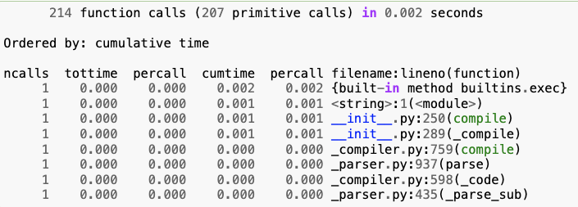
Profiling Tools
Profiling Techniques
Native code
perf (Linux)
gprof
callgrind
Python
cProfile
Java
JProfiler
VisualVM
NetBeans
Ncalls: for the number of calls
Tottime: total time spent in the given function
Percall: quotient of tottime divided by ncalls
Cumtime: cumulative time spent in this and all subfunctions
Percall: the quotient of cumtime divided by primitive calls
Filename: lineno(function)provides the respective data of each function

Slide 13
Monitoring
To detect degradation and catch regressions, need to log and monitor performance metrics
Can measure duration of tests in CI, but benefits from unloaded servers
For services, also need to monitor performance in production
Network conditions, load are dynamic
With scalable microservice architectures, counterintuitive bottlenecks may appear Scaling the wrong components can remove beneficial backpressure

Slide 14
Latency vs. Throughput
Latency: Duration between a single trigger and the system's response
"Tail latency" (e.g. 95th percentile under a specified load) is more important than average
Throughput: Time it takes to processes a fixed amount of work
Often a function of workload
Typically throughput increases with workload size up to a saturation point
Reduce overhead with batching
Typically at expense of latency

Slide 15
Documentation of Testing
Every project needs a test plan that documents the testing procedures for thoroughness, visibility, and for future maintenance.
The test plan should include:
Description of testing approach.
List of test cases and related bugs.
Procedures for running the tests.
Test analysis report.

Slide 16
SQLite: An Example
https://www.sqlite.org/testing.html
640x more test code than application code
Four independently developed test harnesses
100% branch test coverage in an as-deployed configuration
Millions and millions of test cases
Out-of-memory tests
I/O error tests
Crash and power loss tests
Fuzz tests
Boundary value tests
Disabled optimization tests
Regression tests
Malformed database tests
Extensive use of assert() and run-time checks
Valgrind analysis
Undefined behavior checks
Checklists

Slide 17
Fixing Bugs
Isolate the bug
Intermittent --> repeatable
Complex example --> simple example
Understand the bug and its context
Root cause
Dependencies
Structural interactions
Fix the bug
Design changes
Documentation changes
Code changes
Create new test case

Slide 18
Moving the Bugs Around
Fixing bugs is an error-prone process
When you fix a bug, fix its environment.
Bug fixes need static and dynamic testing.
Repeat all tests that have the slightest relevance (regression testing).
Bugs have a habit of returning
When a bug is fixed, add the failure case to the test suite for future regression testing.
Persistence
Most people work around a problem. The best people track down the root cause and fix it for ever

Slide 19
Difficult Bugs
Some bugs may be extremely difficult to track down and isolate. This is particularly true of intermittent failures.
A large central computer stops a few times every month with no dump or other diagnostic.
A database load dies after running for several days with no diagnostics.
An image processing system runs correctly, but uses huge amounts of memory.
Such problems may require months of effort to track down.
For a fictional example, see: Ellen Ullman, The Bug: a Novel, (Doubleday 2003).

Slide 20
Tracking Down a Difficult Bugs: The Heisenbug
A heisenbug (named after the Heisenberg Uncertainty Principle) is a computer bug that
disappears or alters its characteristics when an attempt is made to study it.
Timing While debugging, you run instructions line by line, the delay between operations might be orders of magnitude larger than in production (e.g., the interaction of different thread)
Memory During debug the addresses of variables might change (e.g., affect the precision used for floating point comparisons in some languages)
Assertions When your code is compiled with optimization options activated, assertions are usually disabled, while when compiling in dev mode locally they might likely be active. (Evaluating assertions might have side effects, e.g., timing)

Slide 21
Tracking Down a Difficult Bugs: The Heisenbug
Side-effects of debugging Adding logging or prints change the likelihood of the "wrong" interleaving between threads; the expressions checked in the debug's watches can have the same result, or even worse (if you are not careful) have side effects.
Latency If you are running debug locally, or with mocked services, the latency of sync calls will be orders of magnitude smaller.
Race conditions Execution depends on operating systems, and on the resources available at runtime. Many of these bugs only happen when certain edge conditions are faced.
Randomization Using randomization in your code might cause inconsistencies across different runs, including the happening of bug

Slide 22
Bugs in System Software
Even system software from good manufacturers may contain bugs:
Built-in function in Fortran run-time environment (e0 = 0)
The string-to-number function that was very slow with integers
The preload system with the memory leak

Slide 23
A Note on Testing User Interfaces
User interfaces need several categories of testing.
During the design phase, user testing is carried out with trial users to ensure that the design is usable. Design testing is also used to develop graphical elements and to validate the requirements.
During the implementation phase, the user interface goes through the standard steps of unit and system testing to check the reliability of the implementation.
Finally, acceptance testing is carried out with users, on the complete system.

Slide 24
02
PART TWO
Acceptance Testing

Slide 25
Acceptance Testing
Acceptance testing
The complete system, including documentation, training materials, installation scripts, etc. is tested against the requirements by the client, assisted by the developers.
Each requirement is tested separately.
Scenarios are used to compare the expected outcomes with what the system does.
Emphasis is placed on how the system handles problems, errors, restarts, and other difficulties.
Is the system we have built, the system that you wanted? Does it meet your requirements?

Slide 26
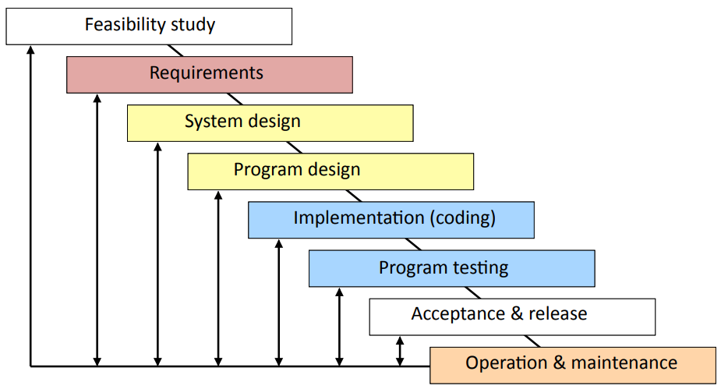
Acceptance Testing in the Modified Waterfall Model

Slide 27
Acceptance Testing with Iterative Development
Iterative development
If the client is properly involved in the development cycle:
The client will have tested many parts of the system, e.g.,
At the end of each iteration
During user testing
Problems and suggestions for improvement will have been incorporated into the system.
BUT: There must still be an acceptance test of the final system before it is released.

Slide 28
Acceptance Testing with Agile Development
Incremental development
Acceptance testing is particularly important with agile development, since each sprint should end with completed code that is ready for release.
Each sprint should be a complete development process, ending with acceptance testing by the client and release.
If several sprints build on each other, each sprint may need to repeat the acceptance tests for earlier sprints to check that they are still met.

Slide 29
Resources for Acceptance Testing
Acceptance Testing is a important part of a software project.
It requires time on the schedule.
It may require substantial investment in test data, equipment, and test software.
Good testing requires good people.
Help systems and training materials are important parts of acceptance testing.

Slide 30
Acceptance Tests
Closed box by the client without knowledge of the internals.
The entire system is tested as a whole.
The emphasis is on whether the system meets the requirements.
The tests should use real data in realistic situations, with actual users, administrators, and operators.
The acceptance tests must be successfully completed before the new system can go live or replace a legacy system.
Completion of the acceptance tests may be a contractual requirement before the system is paid for.

Slide 31
Techniques for Release
The transition from the previous version of a production system to a new release is challenging.
Parallel Testing:
Clients operate the new system alongside the old production system with same data and compare results.
Alpha Testing:
Clients operate the system in a realistic but non-production environment
Beta Testing:
Clients operate the system in a carefully monitored production environment
A/B Testing:
Comparing two versions of a system against each other to determine which one performs better

Slide 32
Release: Parallel Testing
Parallel Testing
For data processing systems, such as financial systems, payroll, etc., the old and the new systems are run together for several productions cycles to check that the new system replicates the functionality of the old.
Requires two sets of everything (staff, equipment, etc.).
Requires software to control changeover (e.g., do not mail two sets of payments).
Requires automated scripts to compare results.
May take several months. Often, the new system will be brought into production in phases.

Slide 33
Release: Alpha and Beta Testing
Alpha testing can be done with software that lacks some functionality. Beta testing requires fully functional system.
Alpha and Beta testing must be managed.
If you simply make versions of the software available to clients:
Many clients will never use it.
Other clients will use a few features.
Only a few clients will test it systematically.
Only a few clients will report problems systematically.
What incentives can you give clients to test your software for you?
Financial (e.g., discounts on products)
Prestige (e.g., recognition, publicity)

Slide 34
Release: A/B Testing
In an A/B test, you take a webpage or app screen and modify it to create a second version of the same page.
Half of your traffic is shown the original version of the page (known as control or A) and half are shown the modified version of the page (the variation or B).
As visitors are served either the control or variation, their engagement with each experience is collected and analyzed through statistical analysis.
Developers can then determine whether changing the experience (variation or B) had a positive, negative or neutral effect against the baseline (control or A).

Slide 35
03
PART THREE
Build systems

Slide 36
What is build system
Build in software development is the process of “translating” source code files into executable binary code files
Compiler is not sufficient anymore when your project get complicated
Cannot find code stored in other parts of the filesystem
Large systems often involve different pieces written in a variety of programming languages with webs of dependencies among those pieces
Build system is a collection of software tools that is used to facilitate the build process

Slide 37
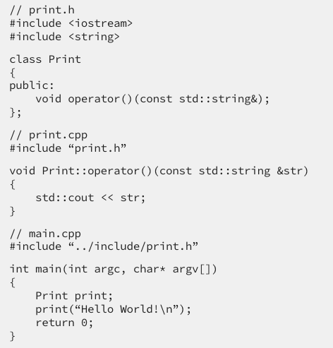
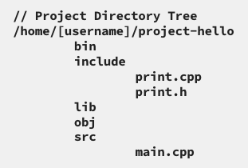
A Make Example

Slide 38
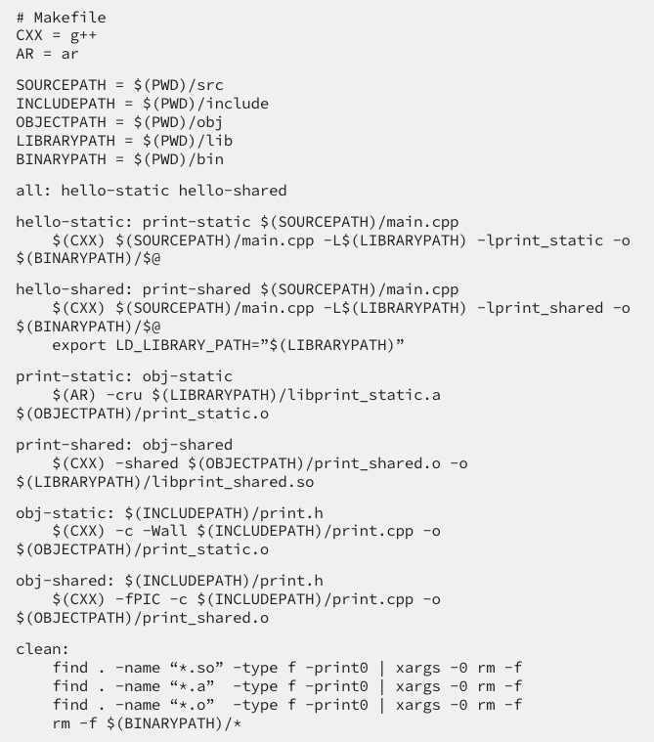
A Make Example
GNU Make build projects following the
information provided in a file called makefile

Slide 39
A Make Example

Slide 40
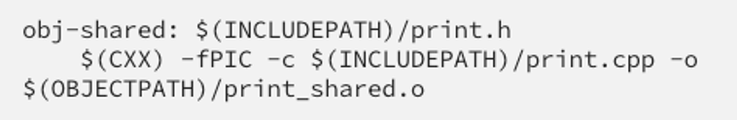
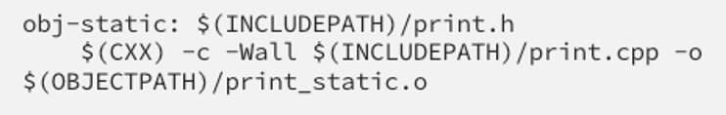
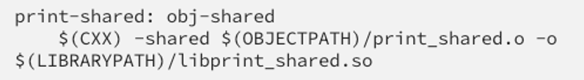
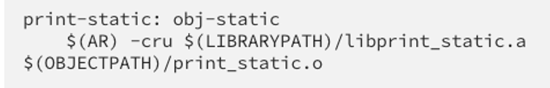
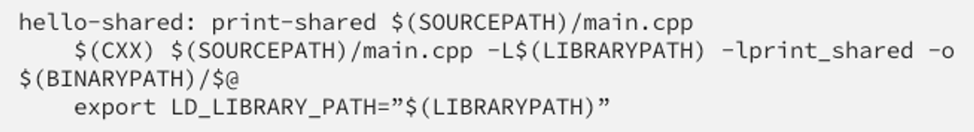

A Make Example
Dependency Graph

Slide 41
A Make Example

Slide 42
A Make Example

Slide 43
A Make Example

Slide 44
With Build Systems
Automate compilation & linkage of all components
Rebuild necessary components when things change
Manage multiple configurations
Manage external dependencies
Automate testing
Automate release actions
Strip debugging symbols
Minify web assets
Generate installers

Slide 45
Options
Write your own scripts
Lots of redundant effort to provide flexibility and functionality
Maintenance cost of bespoke system
Follow conventions
Easy way for new projects to take advantage of build tool features with minimal effort
Good IDE support
Hard to adapt for large, heterogeneous, legacy projects
Difficult to diagnose implicit rules
Can lead to bloated dependencies
Configure a build tool
Must learn a complicated tool & configuration syntax
But knowledge is transferrable
Must maintain build configuration
But being explicit is often good, avoids dependency bloat
Can accommodate custom procedures
Code generation
Multiple languages
IDE may require additional configuration

Slide 46
Build Tools
Common Tools include
GNU Make, Cmake, Maven (Ant +), pip, setuptools, Bazel, etc.
Responsible for constructing dependency graph
Task-based: Targets can execute arbitrary commands
Hard to correctly specify when a task does not need to be rerun
Hard to parallelize safely
Artifact-based: Targets must declare inputs, outputs
Enables safe caching, parallelization

Slide 47
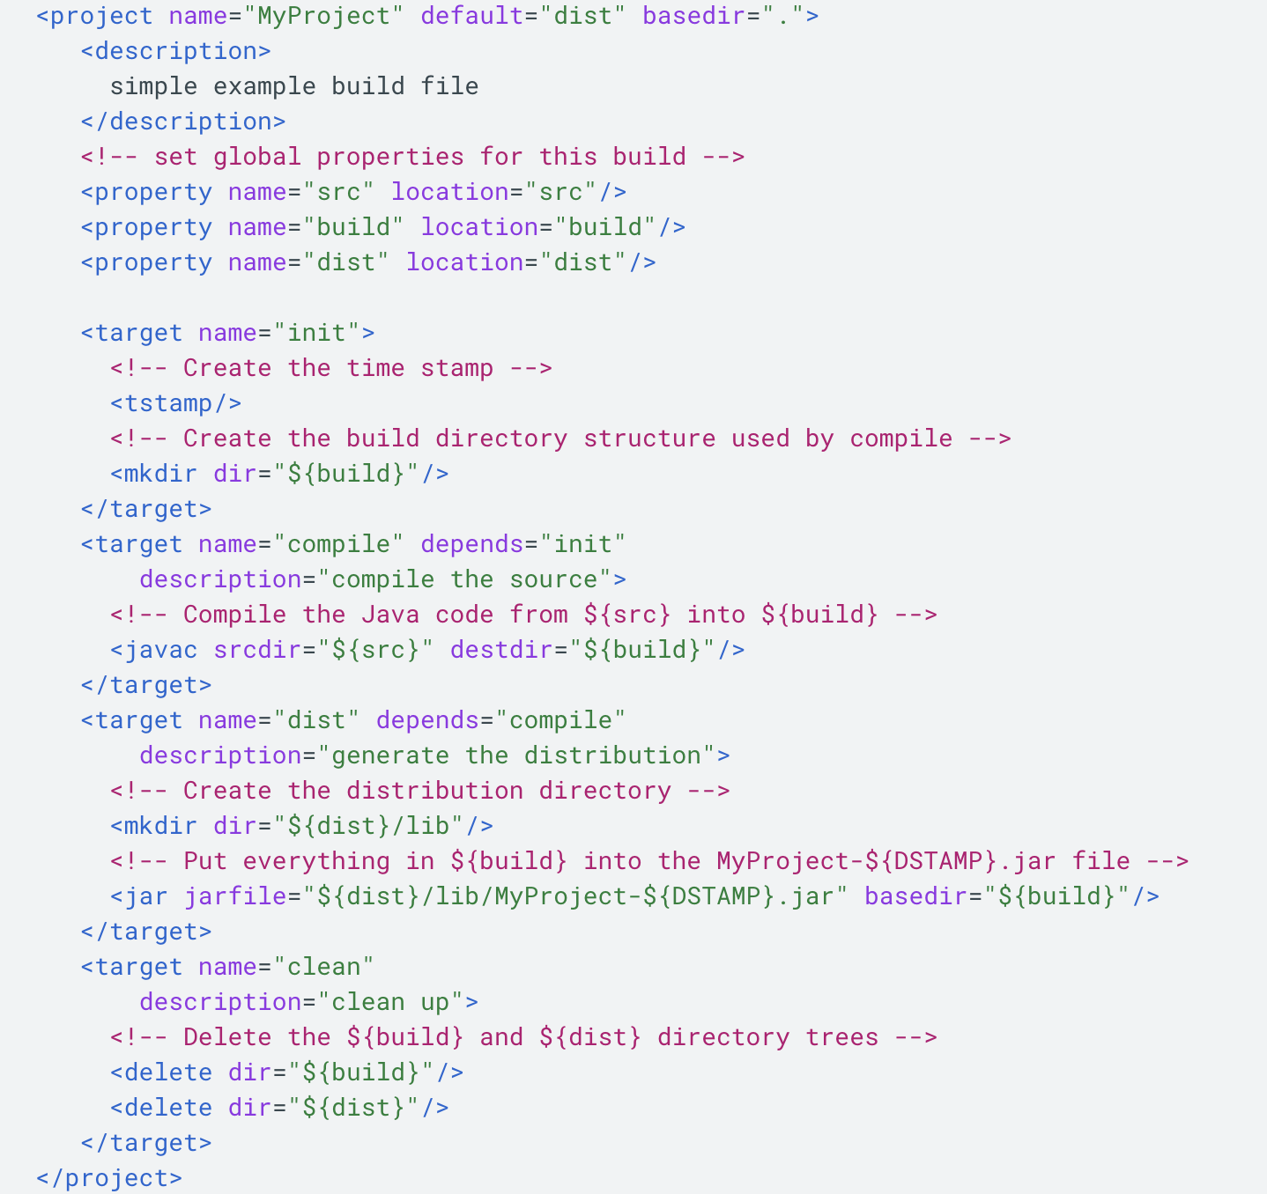
Task-based Build Tool
The buildfile is written in XML and defines some simple metadata about the build along with a list of tasks (the <target> tags in the XML).
Each task executes a list of possible commands defined by Ant, which here include creating and deleting directories, running javac, and creating a JAR file.

Slide 48
Task-based Build Tool
With command line ant dist, the following steps happened:
Loads a file named build.xml
Looks for the task named dist, which has a dependency on the task named compile.
Looks for the task named compile which has a dependency on the task named init
Looks for the task named init and discovers that it has no dependencies.
Executes the commands defined in init, compile and dist Sequentially

Slide 49
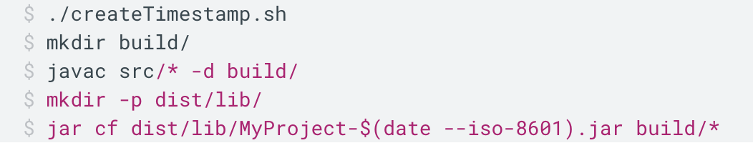
Task-based Build Tool
Equivalent to the following shell script:

Slide 50
Task-based Build Tool
Advantage:
powerful, allowing you to do pretty much anything you can imagine with them
Disadvantage:
Difficulty of parallelizing build steps
Difficulty performing incremental builds
Difficulty maintaining and debugging scripts

Slide 51
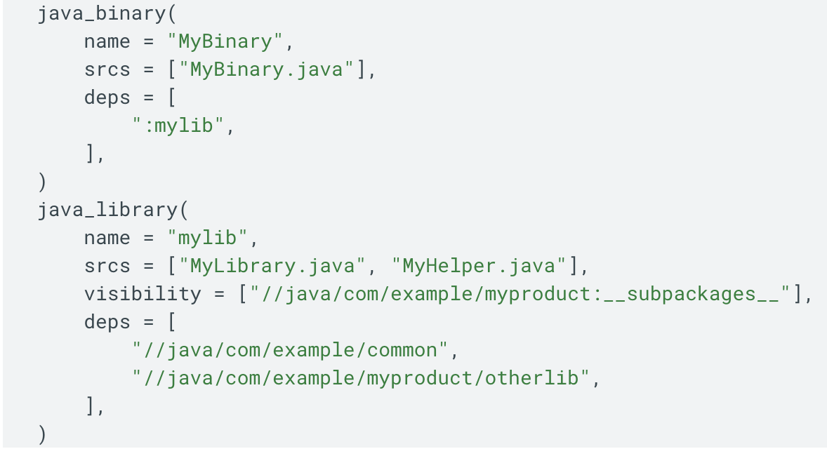
Artifact-based Build Tool （Bazel）
Every target corresponds to an artifact that can be created by the system: java_binary, java_library
name: how the target is referenced on the command line and by other targets
srcs: the source files to compiled to create the artifact for the target
deps: other targets that must be built before this target and linked into it

Slide 52
Artifact-based Build Tool (Bazel)
Bazel build :MyBinary
Create a dependency graph among artifacts.
Uses the graph to determine the transitive dependencies of MyBinary recursively
Builds each of those dependencies, in order.
Builds MyBinary to produce a final executable binary that links in all of the dependencies that were built in step 3.

Slide 53

Bazel (Artifact-based)
Sandboxing to enforce artifact dependencies
Distributed compilation, caching
Test dependencies & caching
Dependencies include env vars, toolchains
Conservative header dependency extraction
Extensible for custom languages, tools

Slide 54
04
PART FOUR
Dependency

Slide 55
Internal vs. external dependencies
Internal
Maintainers' goals are (hopefully) aligned
Can audit for all uses of a library
Can coordinate large-scale changes of all code using library (facilitated by monorepo)
Can manage with source control tools, policies
External
Cannot assume coordination between library and users
Cannot enforce compatibility, maintenance policies
Cannot control release schedule
Danger of diamond dependency problem
Domain of dependency management

Slide 56
Why depend on external code?
Pros
Increase productivity
Benefit from higher quality
External expertise
Incorporate experience from diverse users
Outsource maintenance burden
Cons
Dependence on code outside of your control
Do you have the resources to audit it?
Potential for dependency bloat
Potential for incompatibilities
Supply chain vulnerabilities

Slide 57
Where to get dependencies from?
Defer to users / distributors
E.g. List of Debian packages to install
Common for libraries, system software (C/C++); often used for "standard" dependencies
Build system should confirm that dependencies are satisfied
May assume elevated privileges, may mask portability
Vendors
Copy third party source code (or artifacts) into your repository
Artifact repositories
Download binary artifacts and their transitive dependencies
E.g. Maven Central, Python Wheels, Debian packages
Source code repositories
Download source code and compile locally

Slide 58
Repository mirrors
Depending on public repositories is risky
What if their servers are not available?
What if packages are removed?
Do you trust that an artifact will never change?
Does your employer's firewall block binaries? Do they need to scan for viruses?
Can point build tools to an internal repository mirror, rather than the public Internet
Tradeoff between maintenance and control

Slide 59
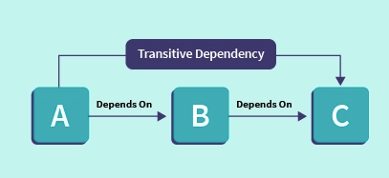
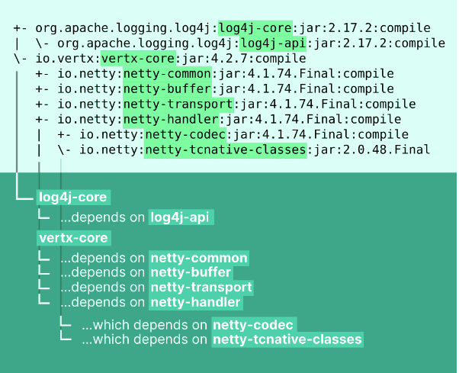
Dependency Tree
Dependencies have their own transitive dependencies
A Java Example:
mvn dependency:tree

Slide 60
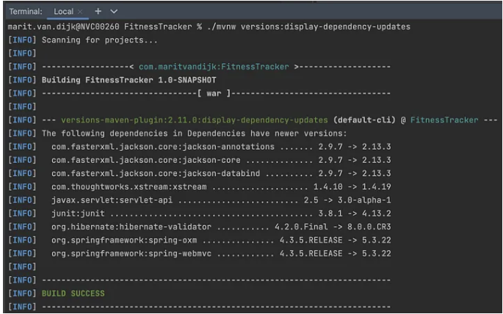
Dependency Management
Dependency Resolution
Process determining and resolving the dependencies between various components or modules of a software system
Make sure any changes or updates to one component do not inadvertently break the functionality of other components.

Slide 61
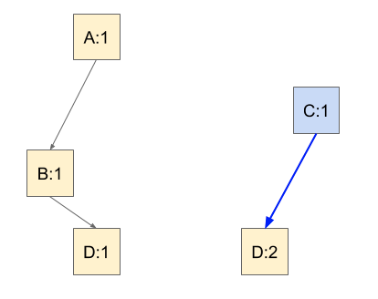
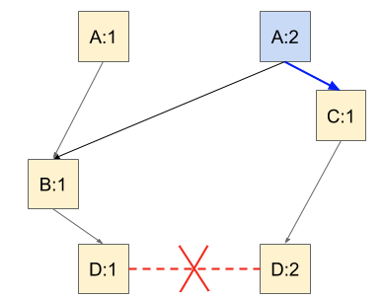
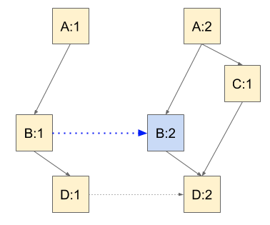
Diamond dependency problem
Two or more libraries in a dependency tree consume a common library using versioned references, and none of the common library versions in those references contain all of the features that the consumers expect.

Slide 62
Dependency Management
What versions of dependencies should you import?
When should you upgrade dependency versions?
Four Options:
Never upgrade
Semantic versioning
Bundled distributions
"Live at HEAD"

Slide 63
Dependency Management
Never upgrade
Predictable
Avoids failures due to changes outside of your control
Natural when starting out, or for short-lived projects
Compatible with "vendoring"
What happens when a dependency has a security vulnerability?
What happens when a new dependency depends on newer versions of old dependencies?
Bundled distributions
Defer dependency management to distribution maintainer
Responsible for maintaining compatibility while incorporating security updates
Depend on the bundle and whatever dependency versions it provides
Common for commercial applications
Limits (verified) portability
Can't leverage latest features

Slide 64
Dependency Management
Semantic Versioning

Slide 65
Dependency Management
Backward compatibility
Code that worked with an older version of a dependency will work with a newer version
Preserved across MINOR versions
Implies that public types and functions cannot be removed
For ABI compatibility, public data structures cannot change outside of "reserved" fields
Forward compatibility
Code built with a newer version of a dependency will also work with an older version
Preserved across PATCH versions
Implies that no new public types, fields, or functions may be added

Slide 66
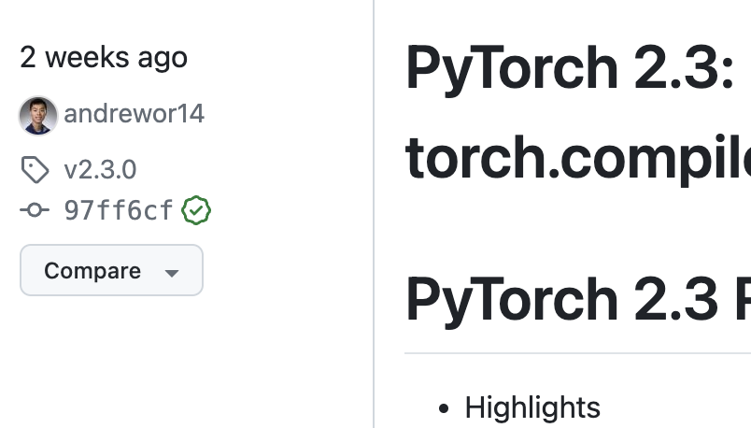
Dependency Management
Semantic Versioning
Dependency version numbers obey MAJOR.MINOR.PATCH format
Changes to PATCH should be fully compatible (bug fixes, security fixes)
Changes to MINOR may add functionality in a backwards-compatible manner
Changes to MAJOR indicate API changes
Assumed by many build tools
Depend on a specific MAJOR version and a minimum MINOR version
In version 2.3.0.X:
2: Major revision (Breaking changes including new API, lots of new features, conceptual change, etc.)
3: Minor revision (maybe a change to a internal logic, 1 feature added, collection of bug fixes)
0: Bug fix release
X: Build number (if used)—Auditing track number

Slide 67
Dependency Management
Semantic Versioning Challenges
Not all dependencies follow this scheme
Human maintainers make mistakes
Hyrum's Law: one person's "bug" is another's "feature"
Can be over-constraining (no solution to SAT problem)
Heuristics for relaxing some requirements

Slide 68

Which version to choose?
For deterministic builds, choice shouldn't depend on when dependency resolution is performed
Lock files: capture results of dependency resolution
Newer dependencies will only be considered if locked versions do not satisfy constraints
Commit lock file to repository
Choosing minimum (MINOR) version required by dependency network
If MINOR versions are maintained as release branches, hopefully security fixes will be backported to them as PATCH releases

Slide 69
"Live at HEAD"
Dependency maintainer responsible for not breaking all users
Effectively requires continuous integration for all software in the world
If compatibility cannot be maintained, maintainer will provide upgrade tool
Some of this infrastructure already exists
"Rolling" Linux distributions (e.g. Gentoo) integrate tens of thousands of packages continuously
Programming languages (e.g. Scala, Rust) proactively test all changes against major libraries/applications

Slide 70
Dependency Vulnerabilities
NPM (a JavaScript package manager ) dependency-related disasters
left-pad unpublished
Bitcoin theft transitive dependency in event-stream
Ukraine war "protestware" in node-ipc
Why was impact so large?
Tools depended on external repository services rather than internal mirror
Projects depended on floating instead of fixed versions
Projects were built "too continuously"
Fine-grained dependencies depended upon by many other libraries

Slide 71
03
PART THREE
Releasing Software

Slide 72
When is software ready to release?
When it is feature-complete?
When it is bug-free?
When it has soaked for long enough?
On the release date?
Continuously?

Slide 73
Traditional release process
Example: GCC
1. Merge window (time-boxed)
Branches that are "ready" are merged to trunk
2. Bug fixes (time-boxed)
Cut release branch
No new (coupled) features
3. Regression & doc fixes
4. Release
When all high-priority bugs are fixed
Challenges
Need to coordinate process
Features that miss merge window must wait until next cycle
Problematic features are difficult to remove
Branch divergence

Slide 74
Time-based vs. Feature-based Releases
Feature-based
Product manager decides which major features define the next release
Developers argue for their features to be included
Which features should hold up release? (tendency for inflation)
Time-based
All features that are completed (tested) by release deadline are included in release
Features that are not ready must wait until next release
Shorter release cadence reduces cost of missing deadline

Slide 75
Risks of Long Release Processes
Delay in providing value to client
May fall behind competition
Slow feedback on feature utility
Drain on morale
Churn among release managers prevents building expertise
Difficult to diagnose issues

Slide 76
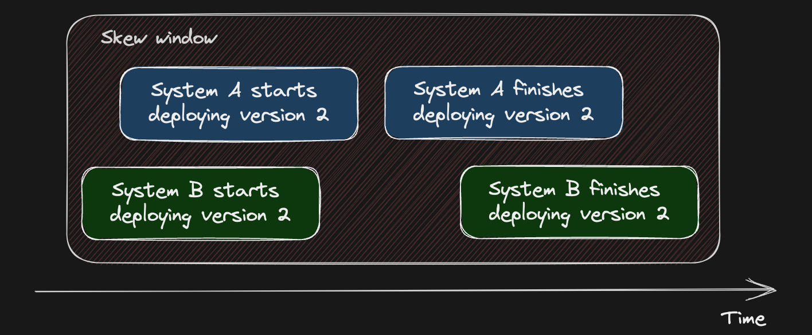
Feature flags
Tying new features to binary builds is risky
Binary rollout and rollback takes time
Risk of version skew
Can't synchronize feature availability with announcement
Fixing a regression requires rolling back all new features

Slide 77

Feature Flag Technique Using Spring Boot
Use application.yml for feature flags in Spring Boot apps. This file usually defines the configuration of an application and simultaneously can be a perfect place for feature toggles:

Slide 78
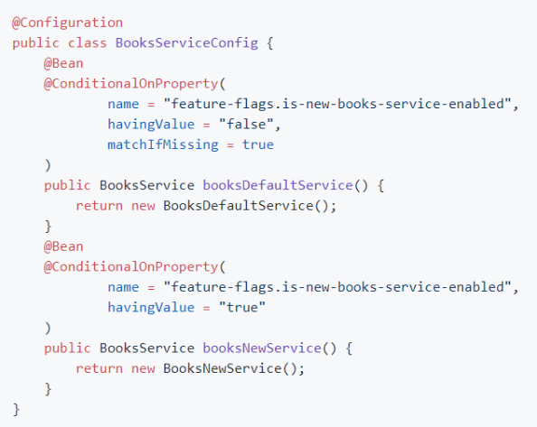
Feature Flag Technique Using Spring Boot
Use @ConditionalOnProperty annotation to turn on implementation options of the feature

Slide 79
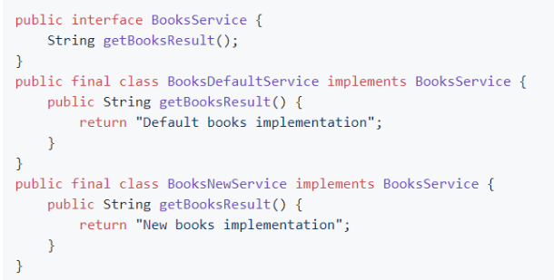
Feature Flag Technique Using Spring Boot
If the feature-flags is-new-books-service-enabled value is -false, or there is no such flag in the configuration, an object from the class BooksDefaultService will be created. For the -true value, an object from the class BooksNewService will be created.

Slide 80
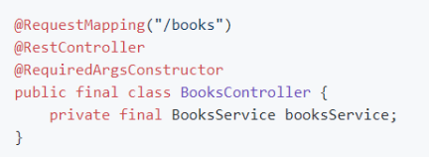
Feature Flag Technique Using Spring Boot
Now, it is possible to use an object of BookService interface with actual implementation (polymorphism in action):

Slide 81
Thanks for your listening!
Instructor: Liu, Guangchi Ph.D.

